Slide 2

The Highlights

Slide 3








Team Highlights
Name | Location
Aanchal Lohia | Mumbai, India
Ravishekhar Gopalan | Toronto, Canada
Chetan Urkudkar | Dublin, USA
Pankaj Khairnar | Mumbai, India
Prashant Hattiholi | Pune, India
Diversity | Yes/No
Gender
Geographic
Cross-functional

Slide 4
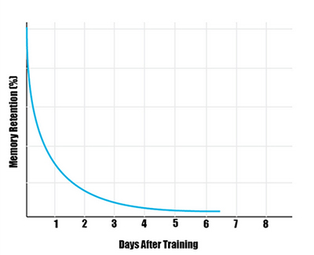
Learning loss is real!
People forget around 50% after a day
Companies spend 70B USD on training in the US alone
Notes:
People forget a big chunk of what they learnt pretty quickly
If our learners forget what they learnt in a matter of days after completing content, it is a very expensive exercise.
This is an opportunity for us to help our learners
References
https://www.goskills.com/Resources/Learning-retention
https://learningsolutionsmag.com/articles/1379/brain-science-the-forgetting-curvethe-dirty-secret-of-corporate-training

Slide 5
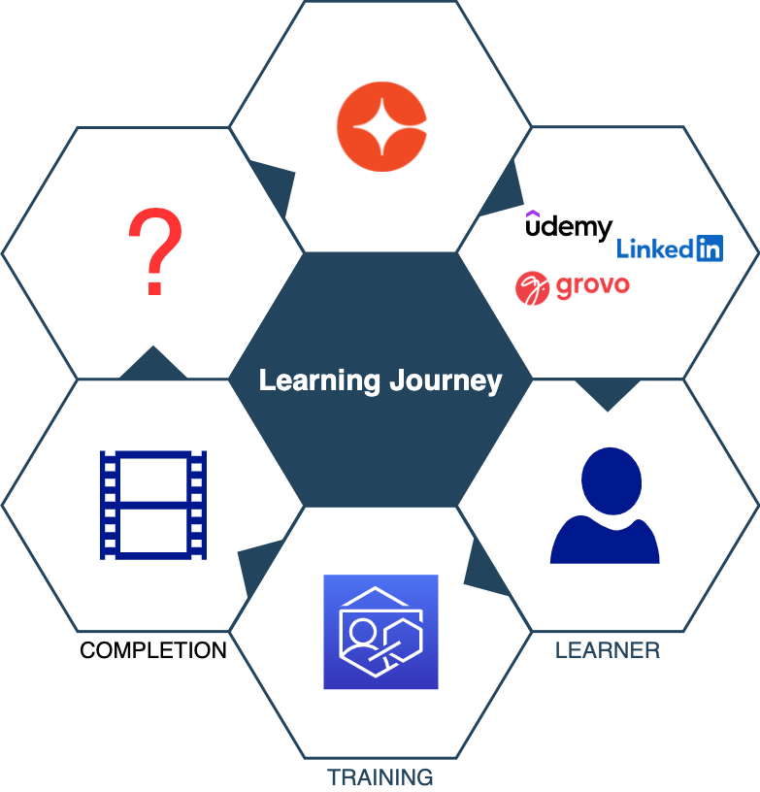
Learning Journey
Notes:
We are with our learners every step of their learning journey.
With this hack, we propose to extend the journey with the realization is that completion is a milestone and the learning journey extends further beyond completion.

Slide 6


From
Retention Burden
To
Ease of access

Slide 7
Solution

Slide 8
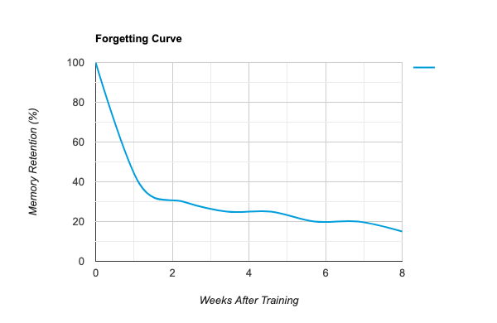
Retention
Spaced Repetition is a widely-used technique
Real-world examples
Highlight text in books/notes
Flashcards
Our hack brings this functionality to our products

Slide 9
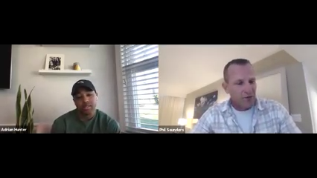
Repetition
Re-inforces
Retention

Slide 10
Demo

Slide 11
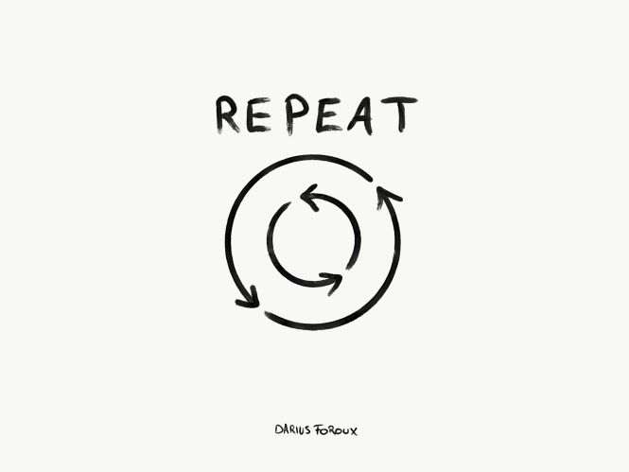


Highlights
Repetition
Relevant bits of content
Context - text, tags
Highlight portlet
Re-inforces
Cycle through user’s highlights
Jog memory
Retention
Retain knowledge longer
Revise highlights only

Slide 12

Benefits
Interactive content
Annotate/tag relevant parts of content
Improve engagement
Product agnostic
Xplor, SabaCloud, Cornerstone LMS
Intelligence
Content with most highlights
Snippets most learners find relevant
Social
Support vote/like of highlights
Context supports tags
Bookmarks
Feedback
Content author gets feedback on relevance

Slide 13
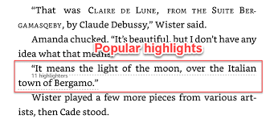

Roadmap
Personalized Highlights
Display all my highlights
Delete highlight
Stats
Popular highlights
Content with most highlights
Intelligence
Highlights based search and recommendations
File types
PDF
Audio

Slide 14
Questions?
cornerstoneondemand.com
Team Highlights
highlights@csod.com

Slide 15
Thank You!

